Slide 1



C++ PROJECT
BANKING
SYSTEM

Slide 2




TEAM
AP22110010197
ADDEPALLI SOMANADHA SAI
AP22110010168
YARRAGUDI BHUVANESH REDDY
AP22110010141
BUGGINNI ROSHINI
AP22110010189
CHEHAK SALUJA

Slide 3



C++ PROJECT
Objectives
Objective 1
Objective 2
Objective 3
The Bank Management System project is a C++ based application that aims to provide an efficient platform for customers and bank staff to manage transactions, accounts, and customer information securely. Its goal is to create a robust and user-friendly application to streamline and automate various banking operations.
Account Management: Establish a method that prioritizes data security and accuracy for the creation, updating, and deletion of client accounts.
Transaction Handling:Provide modules that facilitate fund transfers, withdrawals, and deposits while guaranteeing error-free,real-time transactions.
client Data: To facilitate rapid and safe access to account details, transaction history, and personal information, keep a consolidated database for client data.

Slide 4
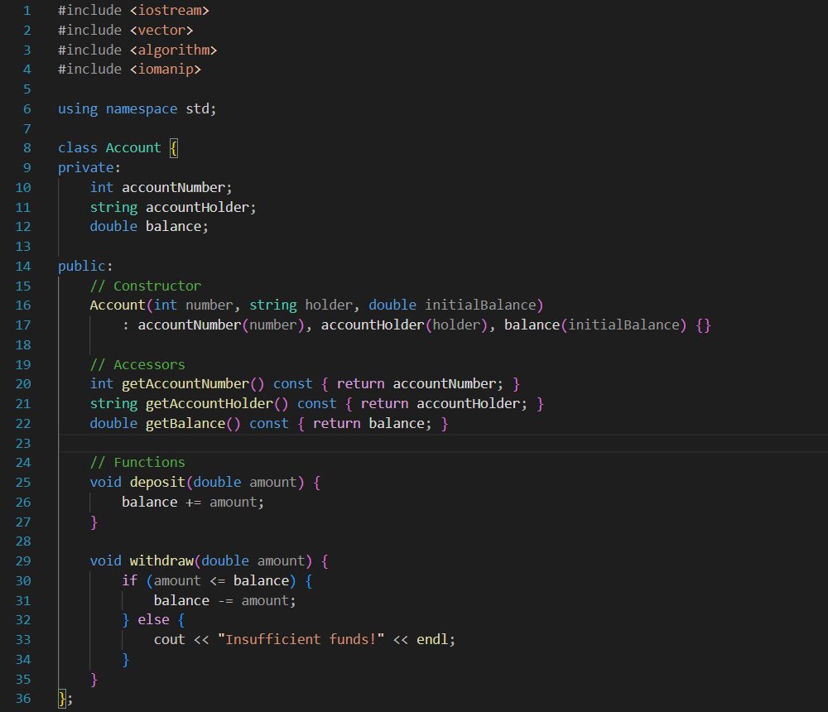
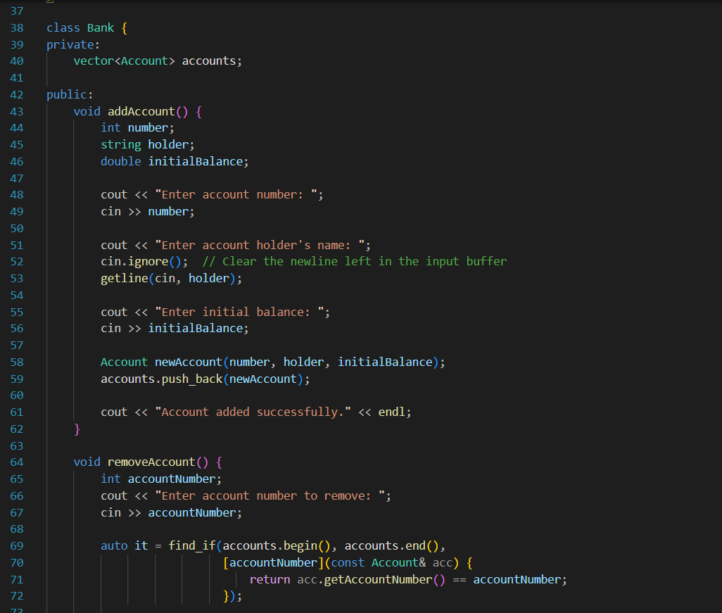
SOURCE CODE

Slide 5
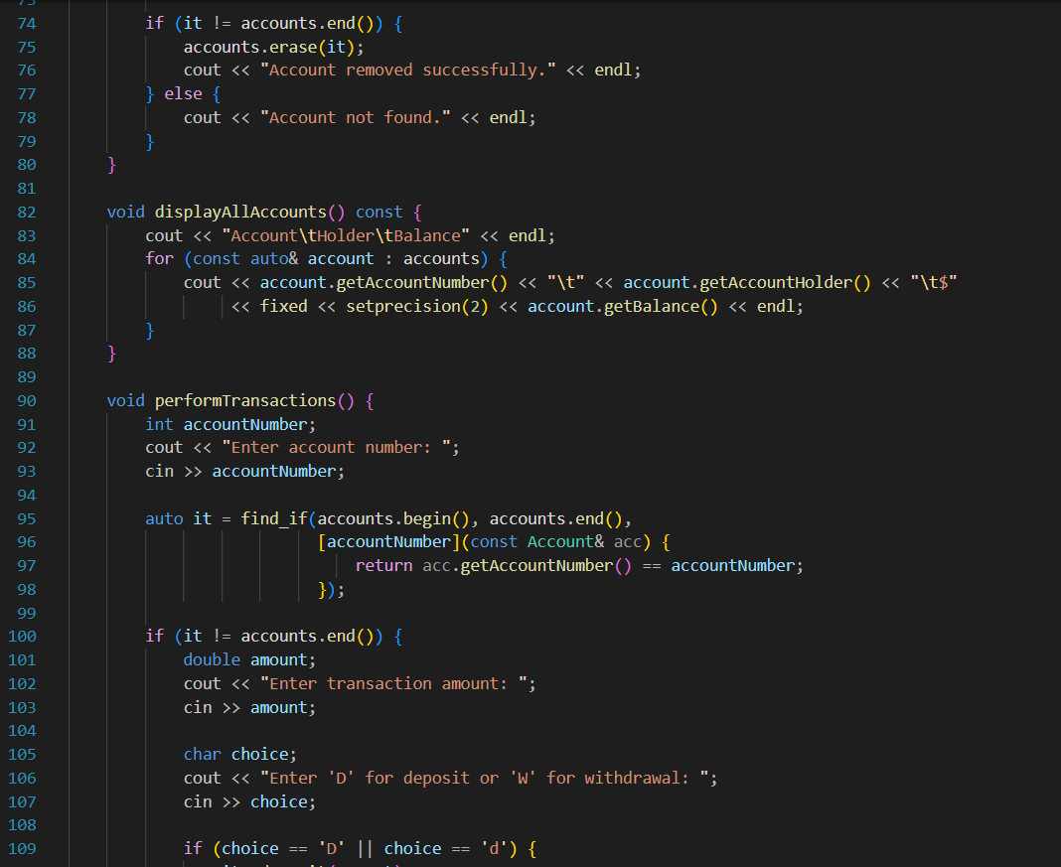


Slide 6
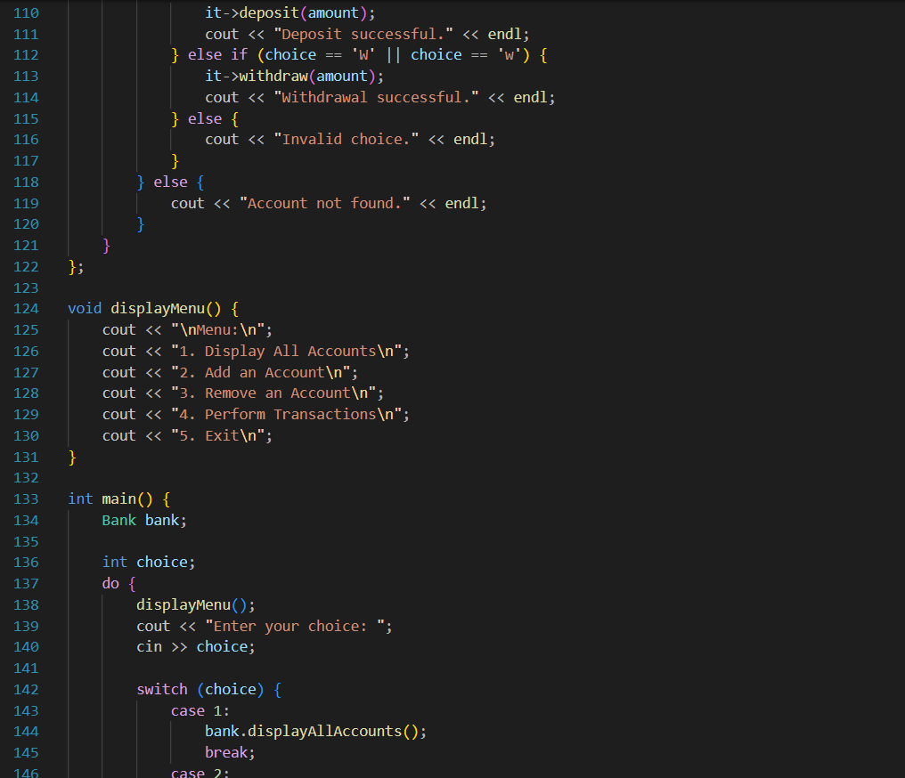
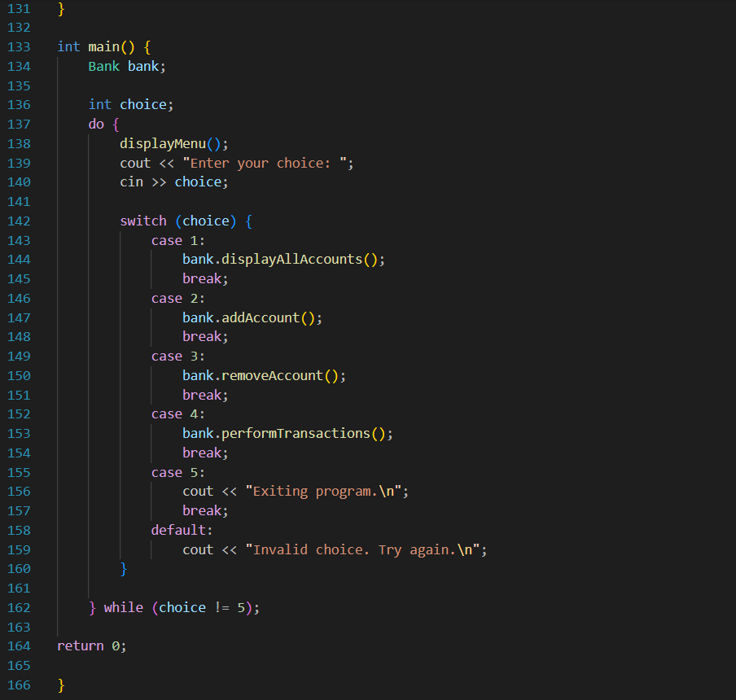

Slide 7
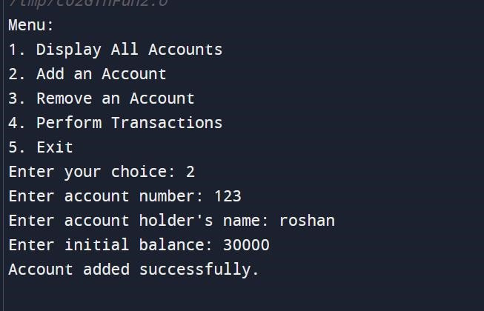
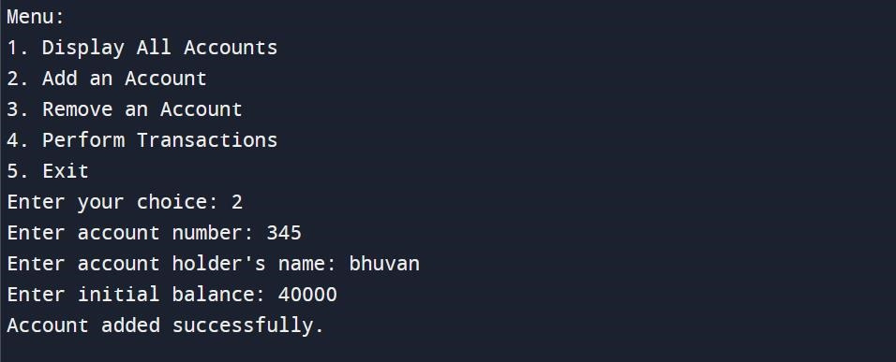
OUTPUT

Slide 8
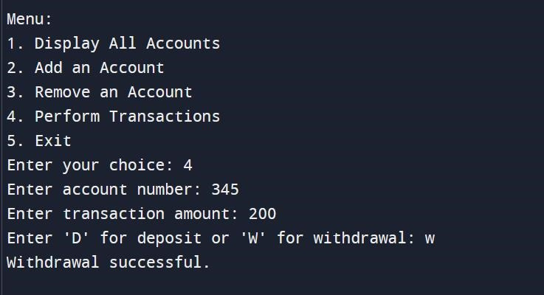
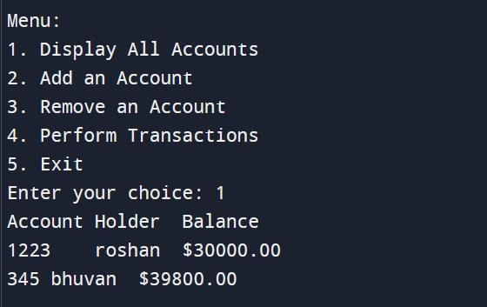
OUTPUT

Slide 9
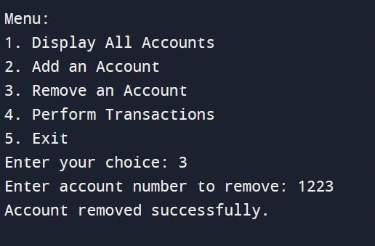
OUTPUT

Slide 10
ALGORITHM
1. Account Class:
- Define a class Account with private attributes accountNumber, accountHolder, and balance.
- Provide a constructor to initialize these attributes.
- Implement accessor methods to retrieve account information.
- Implement functions deposit and withdraw to modify the account balance.
2. Bank Class:
- Define a class Bank with a private vector accounts to store instances of the Account class.
- Implement methods:
- addAccount: Prompt the user for account information and create a new account object, then add it to the accounts vector.
- removeAccount: Prompt the user for an account number, search for the account, and remove it if found.
- displayAllAccounts: Display all accounts in a tabular format.
- performTransactions: Prompt the user for an account number, transaction amount, and transaction type (deposit or withdrawal), and
perform the corresponding operation on the account.
3. Menu Functions:
- Implement a function displayMenu to print the menu options.
4. Main Function:
- In the main function:
- Create an instance of the Bank class.
- Use a do-while loop to repeatedly display the menu and execute the chosen option until the user chooses to exit.
- Switch on the user's choice and call the corresponding method of the Bank class.

Slide 11
Pseudocode
case 1:
bank.displayAllAccounts()
break
case 2:
bank.addAccount()
break
case 3:
bank.removeAccount()
break
case 4:
bank.performTransactions()
break
case 5:
Print "Exiting program."
break
default:
Print "Invalid choice. Try again."
while (choice != 5)
plaintext
class Account:
// ... (as described above)
class Bank:
// ... (as described above)
function displayMenu():
// ... (as described above)
function main():
Create an instance of Bank
choice = 0
do:
displayMenu()
Read user's choice
switch (choice):

Slide 12


C++ PROJECT
THANKYOU

